Slide 1
I2C PROTOCOL
BY SRAVANTHI
CHIPWEAVE TECHNOLOGIES PVT LMD

Slide 2
INTRODUCTION
I2C stands for Inter-Integrated Circuit
It is a two-wire serial communication protocol developed by Philips for short-distance data transfer.
It uses SDA for data and SCL for clock, both controlled by a master device.
I2C supports multiple masters and multiple slaves using unique addresses.
Data is transferred synchronously with ACK/NACK for reliability.
It is widely used to connect sensors, EEPROMs, and peripheral ICs in embedded systems.
Data is transferred 8 bits (1 byte) at a time, followed by 1 ACK/NACK bit → total 9 bits per transfer.
The maximum I²C clock frequency is 3.4 MHz

Slide 3
WHY I2C
Advantages of I²C over SPI
Uses only 2 wires, SPI needs 4+ wires
Built-in addressing, no chip-select lines needed
Lower power consumption
Advantages of I²C over APB
Off-chip and on-chip communication possible
Better suited for board-level peripheral devices
Lower pin count and cost
Advantages of I²C over AXI
Suitable for small peripherals, not high-performance systems
Lower power and easier debugging

Slide 4
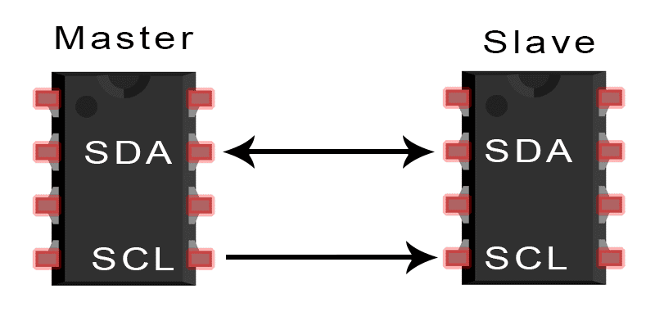
I2C only uses two wires to transmit data between devices:​
SDA (Serial Data) – The line for the master and slave to send and receive data.​
SCL (Serial Clock) – The line that carries the clock signal.​

Slide 5
I2C Signals
I²C uses only two signals for communication:
SDA (Serial Data Line)
  Bi-directional line
  Used to transfer data between master and slave
  Carries address, data, and ACK/NACK bits
SCL (Serial Clock Line)
  Clock signal generated by the master
  Synchronizes data transfer on SDA

Slide 6
Operating modes
I2C can be operated at different speed modes
Up to 100 kbit/s in Standard Mode​
Up to 400 kbit/s in Fast Mode​
Up to 1 Mbit/s in Fast-mode Plus​
Up to 3.4 Mbit/s in High-speed Mode​
Up to 5 Mbit/s in Ultra-Fast Mode​
​

Slide 7
Transferring Data
Data can be transmitted in 2 formats
1)Byte format
2)Acknowledge format
Byte format :
Every byte put on the SDA line must be 8-bits long. The number of bytes that can be transmitted per transfer is unrestricted.
Each byte has to be followed by an acknowledge bit. Data is transferred with the most significant bit (MSB) first .
If a slave can’t receive or transmit another complete byte of data until it has performed some other function, for example servicing an internal interrupt, it can hold the clock line SCL LOW to force the master into a wait state.

Slide 8
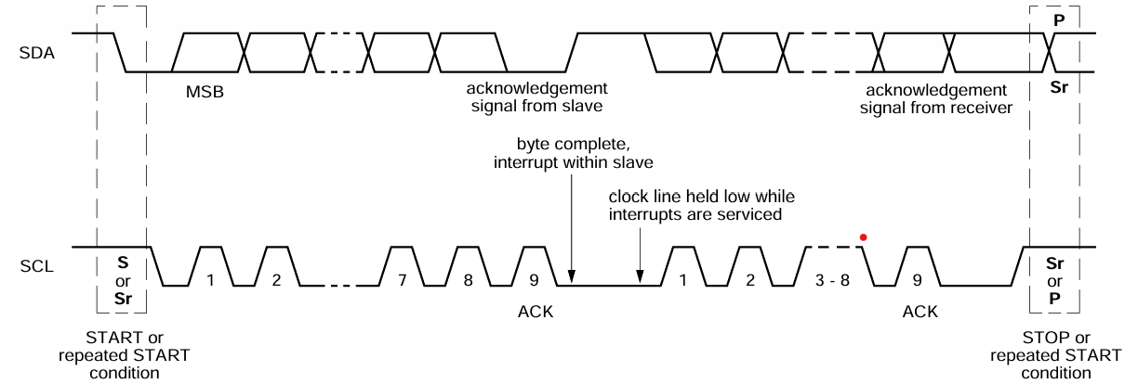
Data transfer then continues when the slave is ready for another byte of data and releases clock line SCL.
In some cases, it’s permitted to use a different format from the I2C-bus format . A message which starts with such an address can be terminated by generation of a STOP condition, even during the transmission of a byte. In this case, no acknowledge is generated .

Slide 9
Acknowledgement Format
The acknowledge-related clock pulse is generated by the master. The transmitter releases the SDA line (HIGH) during the acknowledge clock pulse. The receiver must pull down the SDA line during the acknowledge clock pulse so that it remains stable LOW handbook, full pagewidth SDA SCL or MSBS during the HIGH period of this clock pulse.
set-up and hold times must also be taken into account. Usually, a receiver which has been addressed is obliged to generate an acknowledge after each byte has been received, except when the message starts with a CBUS address.
When a slave doesn’t acknowledge the slave address , the data line must be left HIGH by the slave. The master then generate either a STOP condition to abort the transfer, or a repeated START condition to start a new transfer.
If a slave-receiver does acknowledge the slave address but, some time later in the transfer cannot receive any more data bytes, the master must again abort the transfer. This is indicated by the slave generating the not-acknowledge on the first byte to follow.

Slide 10
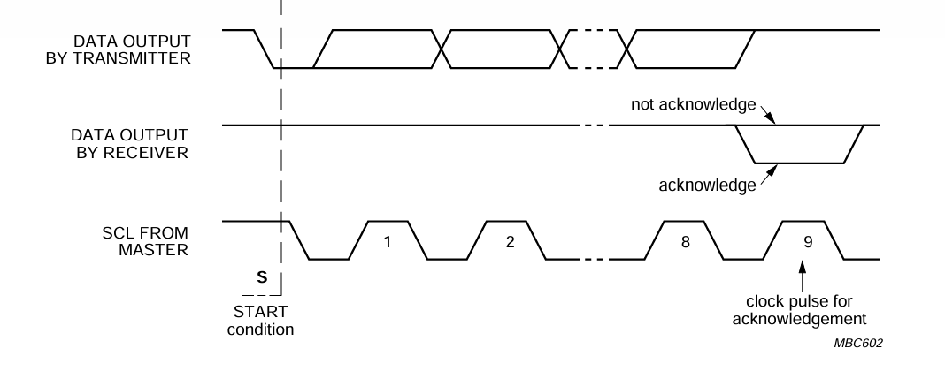
Acknowledge on I2C
The slave leaves the data line HIGH and the master generates a STOP or a repeated START condition. If a master-receiver is involved in a transfer, it must signal the end of data to the slave- transmitter by not generating an acknowledge on the last byte that was clocked out of the slave. The slave-transmitter must release the data line to allow the master to generate a STOP or repeated START condition.

Slide 11
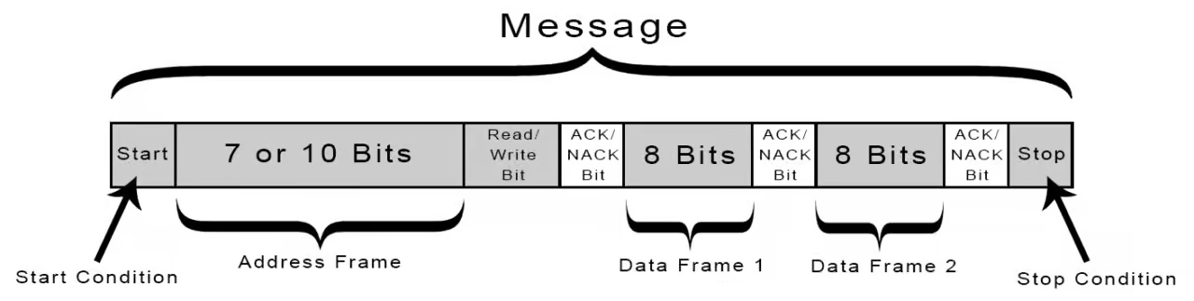
Working of I2C
With I2C, data is transferred in messages. Messages are broken up into frames of data. Each message has an address frame that contains the binary address of the slave, and one or more data frames that contain the data being transmitted.
The message also includes start and stop conditions, read/write bits, and ACK/NACK bits between each data frame:

Slide 12
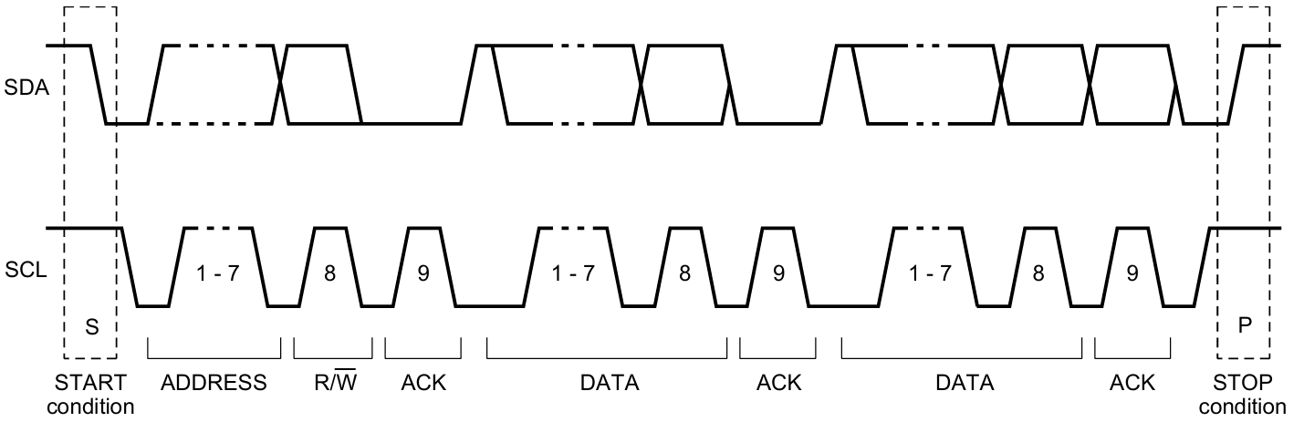
Data Frame of I2C
Start Condition: SDA line switches from a high voltage to low voltage level before the SCL line switches from high to low.
Stop Condition: SDA line switches from a low voltage to high voltage level after the SCL line switches from low to high.
A START and STOP condition are always asserted by the master.

Slide 13
Address Frame:
    A 7-bit or 10-bit unique sequence used to identify the slave device when the master wants to communicate with it.
Read/Write Bit
    This bit specifies the direction of data transfer. If the master device/IC need to send data to a slave device, this bit is set to ‘0’. If the master IC needs to receive data from the slave device, it is set to ‘1’.
ACK/NACK Bit
    It stands for Acknowledged/Not-Acknowledged bit. If the physical address of any slave device coincides with the address broadcasted by the master device.
    The value of this bit is set to ‘0’ by the slave device. Otherwise it remains at logic ‘1’ (default).
Data Block
    It comprises of 8 bits and they are set by the sender, with the data bits it needs to transfer to the receiver. This block is followed by an ACK/NACK bit and is set to ‘0’ by the receiver if it successfully receives data. Otherwise it stays at logic ‘1’.

Slide 14
Advanced Features
Synchronization:
All masters generate their own clock on the SCL line to transfer messages on the I2C-bus. Data is only valid during the HIGH period of the clock. A defined clock is needed for the bit-by-bit arbitration procedure to take place.
Clock synchronization is performed using the wired-AND connection of I2C interfaces to the SCL line. This means that a HIGH to LOW transition on the SCL line will cause the devices concerned to start counting off their LOW period and, once a device clock has gone LOW, it will hold the SCL line in that state until the clock HIGH state is reached .
However, the LOW to HIGH transition of this clock may not change the state of the SCL line if another clock is still within its LOW period. The SCL line will therefore be held LOW by the device with the longest LOW period.

Slide 15
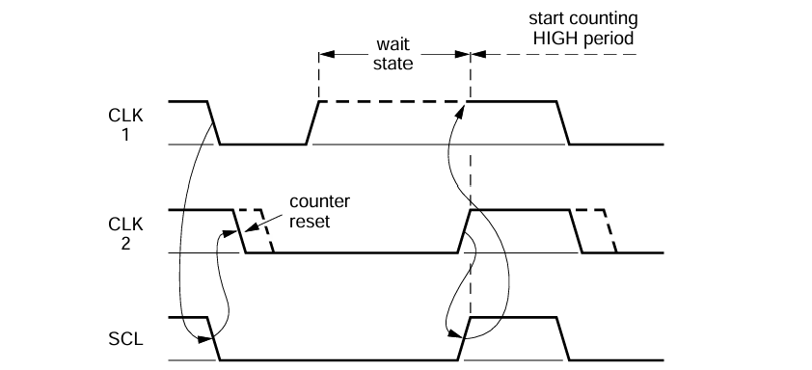
Synchronization
There will then be no difference between the device clocks and the state of the SCL line, and all the devices will start counting their HIGH periods. The first device to complete its HIGH period will again pull the SCL line LOW.
In this way, a synchronized SCL clock is generated with its LOW period determined by the device with the longest clock LOW period, and its HIGH period determined by the one with the shortest clock HIGH period

Slide 16
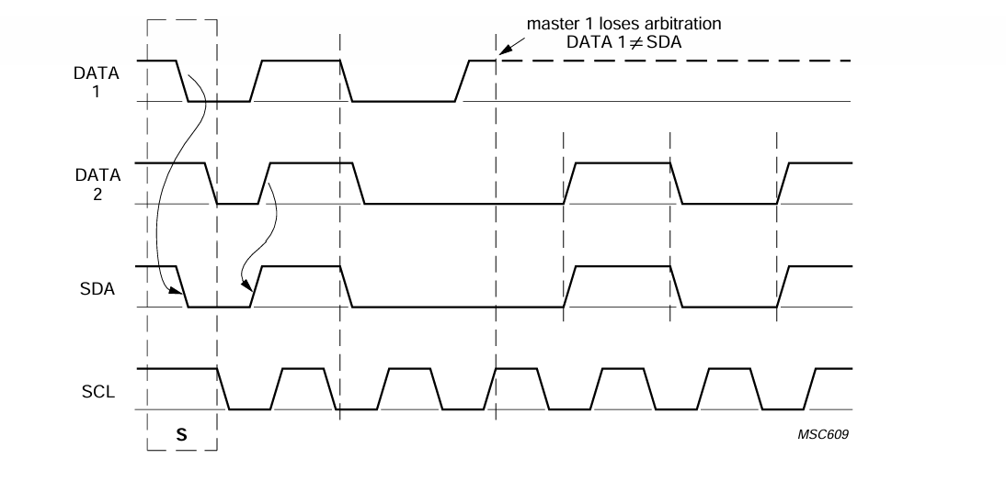
Arbitration
Multi-Master Arbitration
    I2C supports multi-master configurations, allowing multiple master devices to share the bus. Collision detection and resolution mechanisms ensure that data integrity is maintained during simultaneous access attempts.

Slide 17
Advantages&Disadvantages
Advantages
Only uses two wires
Supports multiple masters and multiple slaves
ACK/NACK bit gives confirmation that each frame is transferred successfully
Hardware is less complicated
Well known and widely used protocol
Error Detection
Disadvantages
Slower data transfer rate than SPI
The size of the data frame is limited to 8 bits
More complicated hardware needed to implement than SPI

Slide 18


